Slide 1
DIGITAL DESIGN & COMPUTER ARCHITECTURE
DESIGN AND SIMULATION OF A DIGITAL DOOR LOCK SYSTEM USING LOGIC GATES
A simple password-matching circuit
Team Members & Roll Numbers: K.Rithwik (2620040124)
G.Veerendranath Reddy (2620030373)
Deepak surya (2620090129)
Likith Chandra (2620040104)
Guide: Dr. Venkanna Isampalli
Department of Freshman Engineering | Academic Year 2026–27
01

Slide 2
Introduction
Turning a correct digital code into an unlock signal
The idea
Logic-gate approach
A digital door lock checks a binary password entered by the user.
NOT and AND gates compare the entered bits with a preset code.
Expected result
Correct code → UNLOCK indicator ON
Incorrect code → LOCK indicator ON
This is an educational logic-circuit prototype, not a certified security lock.
02

Slide 3
Objectives
Project goals
1
Design a basic digital door lock using logic gates.
2
Represent the password as a 4-bit binary code.
3
Build a Boolean expression that detects the correct code.
4
Test the circuit for correct and incorrect inputs.
5
Connect the project to digital design concepts in the course handout.
03

Slide 4
COURSE OUTCOMES (COs)
Mapped to the six official outcomes in the course handout
CO1
Understand the basic organization of a computer system and represent digital information using binary number systems and logic gates as the foundation of digital computing.
CO2
Design and simulate combinational logic and build a simple Arithmetic Logic Unit (ALU) — the part of the processor that computes.
CO3
Design, analyze, and integrate sequential logic circuits including flip-flops, registers, shift registers, counters, program counter, and finite state machines for synchronous digital systems and RISC-V processor applications.
CO4
Design and implement the register file and memory subsystem of a processor, and explain the role of memory hierarchy in computer systems.
CO5
Analyze the execution of RISC-V instructions, develop simple RISC-V assembly programs, and integrate the data path and control unit to implement a functional single-cycle processor.
CO6
Enhance a single-cycle RISC-V processor by designing and implementing architectural extensions and peripheral interfaces using Project-Based Learning.
Project focus: CO1 (digital foundations) and CO2 (combinational logic design). CO3–CO6 are included as the full course outcomes.

Slide 5
Components Required
Suggested parts for a simple demonstrator
Logic components
Build and test tools
• 5 V DC supply
• NOT gate (e.g., 7404)
• AND gates (e.g., 7408)
• 4 input switches for A, B, C, D
• LEDs for LOCK and UNLOCK
• Current-limiting resistors
• Breadboard and jumper wires
• Logic simulator: Logisim Evolution or Digital
• Optional: transistor/driver stage for a physical lock actuator
• Do not connect a door strike directly to logic IC outputs
05

Slide 6
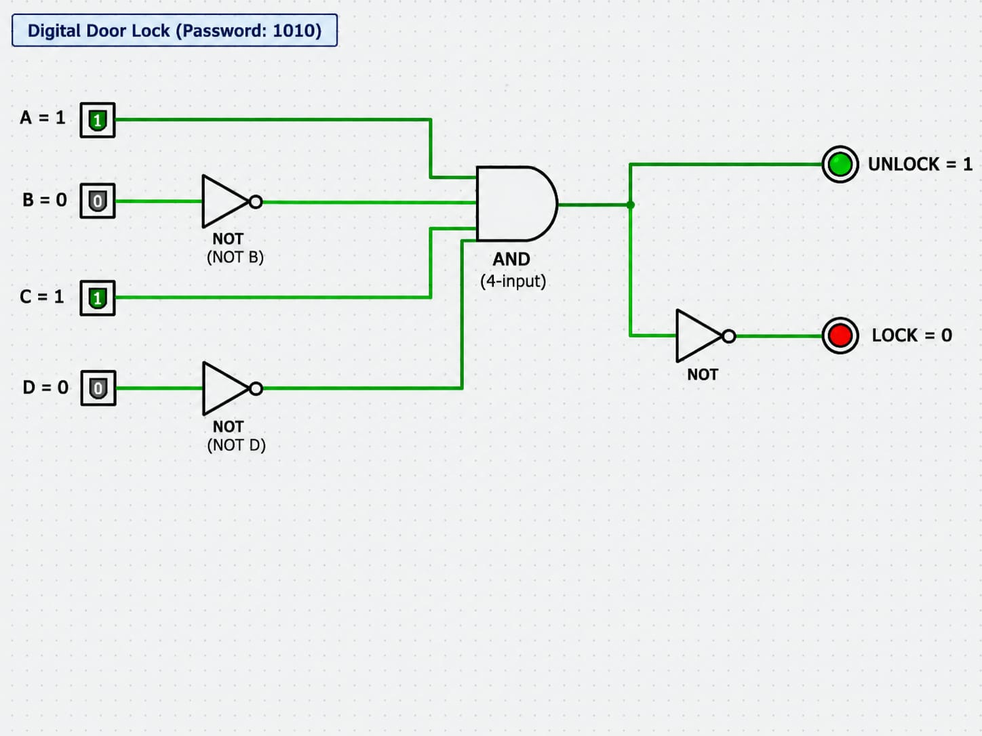

Slide 7
Circuit Working
Password match operation
1
The user enters four binary bits using switches A, B, C and D.
2
The preset password for this design is 1010.
3
NOT gates produce B̅ and D̅, needed because those password bits are 0.
4
An AND gate combines A, B̅, C and D̅ to detect the exact code.
5
When the expression is 1, UNLOCK turns ON; otherwise, LOCK remains ON.
07

Slide 8
Truth Table
Preset code = 1010
A | B | C | D | UNLOCK | LOCK
0 | 0 | 0 | 0 | 0 | 1
0 | 0 | 0 | 1 | 0 | 1
0 | 0 | 1 | 0 | 0 | 1
0 | 0 | 1 | 1 | 0 | 1
0 | 1 | 0 | 0 | 0 | 1
0 | 1 | 0 | 1 | 0 | 1
0 | 1 | 1 | 0 | 0 | 1
0 | 1 | 1 | 1 | 0 | 1
1 | 0 | 0 | 0 | 0 | 1
1 | 0 | 0 | 1 | 0 | 1
1 | 0 | 1 | 0 | 1 | 0
1 | 0 | 1 | 1 | 0 | 1
1 | 1 | 0 | 0 | 0 | 1
1 | 1 | 0 | 1 | 0 | 1
1 | 1 | 1 | 0 | 0 | 1
1 | 1 | 1 | 1 | 0 | 1
1 = ON / HIGH | 0 = OFF / LOW
08

Slide 9
Logic Design
Boolean expression for the preset code 1010
Required match
Boolean expression
A = 1, B = 0, C = 1, D = 0
UNLOCK = A · B̅ · C · D̅
Complemented bits
Lock indicator
B̅ = NOT B and D̅ = NOT D
LOCK = NOT(UNLOCK)
The AND output becomes HIGH only when all four required conditions are true.
09

Slide 10
Advantages
Why this design is useful
1
Simple and inexpensive logic-circuit demonstration.
2
No software programming is required for the basic circuit.
3
Clearly demonstrates binary inputs, Boolean expressions and gates.
4
Easy to simulate and test using different code combinations.
5
Can be expanded into a larger digital access-control project.
11

Slide 11
Limitations
Important design boundaries
1
A 4-bit code has only 16 possible combinations and is not secure for real use.
2
The basic circuit does not store failed attempts or limit repeated guesses.
3
Power loss and switch glitches may affect a physical prototype.
4
Logic-gate outputs cannot directly drive a high-current door lock actuator.
5
A practical product needs secure code storage, enclosure, and safety testing.
12

Slide 12
Applications & Future Scope
Possible extensions beyond the basic model
Applications
Future improvements
• Digital logic laboratory demonstration
• Basic access-control prototype
• Learning project for Boolean logic
• Entry-level embedded hardware concept
• Increase password length
• Add a keypad interface
• Add a flip-flop/latch for state holding
• Add attempt counter and alarm
• Use a protected driver circuit for an actuator
Advanced features would introduce sequential logic (Module 3) and additional control design.
13

Slide 13
Conclusion
A small practical example of digital design
What was designed
A logic circuit that recognizes the preset binary password 1010.
What it demonstrates
NOT and AND gates, Boolean expressions, truth tables, and combinational circuit testing.
The project connects Module 1 digital foundations with Module 2 combinational logic design.
14

Slide 14
Project Files / GitHub
Add your repository URL after uploading your work
Repository Link
https://github.com/Rithwik-Builds/DDCA-Presentation
Suggested contents
README should include
PPT, circuit diagram, simulation file, truth table, project report.
Project aim, logic expression, how to simulate, test cases, team contributions.
15

Slide 15
THANK YOU
Questions & Discussion
DIGITAL DOOR LOCK SYSTEM USING LOGIC GATES

